Slide 1


Recognize, Respond, Refer
Guiding Victims of Cybercrime

Slide 2



Who We Are
Our Mission: Empower our society to recognize, report and recover from fraud and scams to foster a safer digital world.
Recognize.
Report.
Recover.

Slide 3



Why This Matters
Money stolen
is skyrocketing
The impact isn’t just financial
Underserved communities are especially vulnerable

Slide 4

Understanding the Victim Experience
Shame, isolation, and stigma keep people silent
When scams end, it can feel like “grieving without a funeral”
Recovery is about more than recovering funds
Notes:
CSN is frequently asked how we define cybercrime. There are more than 36 categories of cybercrime as defined by the FBI IC3. We define cybercrime in two ways. First cybercrime is a crime that is only happening because the Internet exists like Ransomware and DDOS (Denial of Service) attacks. Hacked device
The other type is crime enhanced by the Internet. For example, identity theft and romance scams have happened for years, but are now enhanced and happening more often.

Slide 5

Recognizing When A Scam is Happening
Signs that someone is being affected by a scam:
Behavioral changes (moody, isolated, stressed)
Financial changes or strain
No in-person meetings
Notes:
JEN
Helping victims of romance scams involves a delicate process of "de-programming," which refers to undoing the emotional and psychological manipulation victims experience:
Importance of peer support:
Peer support fosters a sense of belonging, empowers victims, and aids in both emotional and practical recovery. It complements professional interventions by offering continuous, compassionate, and relatable support that strengthens the deprogramming process.
Shared Understanding and Empathy
Validation of Experience: Victims of romance scams often feel isolated, ashamed, or embarrassed, fearing judgment from others. Peer support groups made up of people who have gone through similar experiences provide validation and reduce feelings of isolation.
Emotional Comfort: Hearing stories from others who have survived similar scams can be incredibly reassuring. Peers are able to share not only their hardships but also how they coped, providing hope for recovery.
Normalizing Emotions and Reactions
De-stigmatization: Many victims blame themselves or believe they should have "known better." Peer support can help normalize these feelings and reactions, showing victims that emotional manipulation is a common and powerful tactic used in romance scams.
Mutual Support: When victims interact with peers who express similar emotions, they feel less abnormal or foolish. This sense of belonging helps to reduce shame and guilt, which are often barriers to healing.
Empowerment through Shared Experiences
Learning from Others: Hearing how others overcame the emotional attachment to the scammer or rebuilt their lives after financial loss can inspire victims to take steps toward their own recovery.
Mutual Encouragement: Victims can encourage and challenge each other in ways that a professional might not be able to. Sharing coping strategies, resources, or simple words of encouragement can promote resilience and agency.
Fostering a Sense of Community
Rebuilding Trust: Romance scams often leave victims struggling with trust issues. Peer support offers a safe, non-judgmental environment where they can begin to rebuild trust with others who genuinely understand their pain.
Combatting Isolation: Victims often withdraw from friends and family due to shame or confusion. Peer support fills this gap, helping them reconnect socially and emotionally with others.
Enhancing Long-Term Recovery
Sustained Support: While professional interventions are crucial, they often have a limited duration. Peer support groups can provide ongoing, long-term recovery help, ensuring that victims don’t feel abandoned after professional services end.
Role Models of Resilience: Witnessing others' successful recovery journeys can help victims develop hope and perseverance in their own healing process. Peer support offers living examples of resilience, which can be incredibly motivating.
Providing Practical Advice
Real-Life Solutions: Peers may offer practical advice about things like reporting scams to authorities, navigating financial recovery, or how to disengage emotionally from the scammer. These real-world tips can complement the psychological tools provided by professionals.
Sharing Resources: Peer groups often become valuable networks for sharing resources, such as information on scam prevention, financial advice, and emotional coping mechanisms.
Encouraging Self-Efficacy and Empowerment
Peer Mentorship: Victims who have made significant progress can take on a mentoring role within the group, empowering both themselves and newer members. This gives survivors a sense of agency and control over their recovery, enhancing self-efficacy.
Shifting from Victim to Survivor: Being part of a community where others have successfully moved beyond victimhood helps individuals reframe their identity from victim to survivor, a key step in the deprogramming process.
Reducing the Risk of Revictimization
Education on Red Flags: Peer groups can also serve as a platform for discussing warning signs of scams and tactics used by fraudsters. Educating each other reduces the likelihood of future victimization.
Accountability and Vigilance: Peer support members can hold each other accountable for maintaining boundaries and staying vigilant against further manipulation, offering a form of informal protection against falling into similar traps.
Build Trust and Rapport
Initial Engagement we create a safe, non-judgmental space for the victim. Many victims feel embarrassed or ashamed, so building rapport is essential to encourage open communication.
Active Listening: Importance placed on listening attentively to the victim’s story, validating their emotions without belittling their experiences.
Assess the Extent of the Manipulation
Emotional and Financial Assessment: A thorough assessment of the scam's emotional and financial impact is conducted. This includes exploring the victim's emotional attachment to the scammer, the depth of the relationship, and financial losses.
Cognitive Dissonance: victims often struggle with conflicting emotions, believing they were in a genuine relationship despite signs of deception. The group helps them process these contradictions.
Psychoeducation
Understanding the Scam: educating victims about common tactics used in romance scams, such as “love bombing,” emotional manipulation, and financial exploitation. Understanding the psychology behind scams can help victims come to terms with their experiences.
Fraud Awareness: victims are taught about how fraudsters exploit vulnerabilities and are guided through the mechanics of how they were scammed, which can help dismantle the emotional bond they feel with the scammer.
Emotional Support and Counseling
Trauma Informed: many victims experience trauma, anxiety, depression, or feelings of worthlessness. Therapeutic interventions, such as trauma-informed cognitive behavioral therapy (CBT), can help victims process their emotions and rebuild self-esteem.
Grief processing/ peer support: for some, the emotional attachment feels like a genuine loss. Peers can provide support to help victims mourn the “relationship” they thought they had.
Cognitive Restructuring
Challenging Beliefs: Victims may hold onto false beliefs or remain emotionally attached to the scammer. Facilitator helps challenge and reconstruct these beliefs by providing facts and cognitive-behavioral techniques to shift thinking patterns.
Reality Testing: Encouraging the victim to examine the scammer’s claims, behaviors, and inconsistencies can help them see the deception more clearly.
Building Resilience and Coping Strategies
Empowerment: Victims are encouraged to reclaim their autonomy and make informed decisions going forward. Empowering them helps to restore their sense of control over their lives.
Self-Care and Support Systems: Social workers help victims reestablish self-care routines and connect with supportive friends, family, or peer groups to prevent further isolation.
Long-Term Follow-Up and Support
Preventing Recurrence: Facilitator helps victims recognize red flags to prevent future scams, offering ongoing check-ins or referrals to peer support groups.
Rebuilding Trust: Victims may find it difficult to trust others again. Long-term support involves helping victims rebuild trust in themselves and their ability to form healthy relationships.
Through these steps, our group helps romance scam victims regain emotional stability, financial security, and trust, while dismantling the manipulative tactics that led them to be victimized.
Challenges:
Vulnerability
Unfulfilled Needs
Loneliness
Stories?

Slide 6
How to Talk with Someone Affected
Use trauma-informed, empathetic language
1
Listen more than you talk
2
Meet them where they are
3
Avoid language like “How could you fall for that?”
4
Validate: “You’re not alone. This happens to many people.”
5
Notes:
JEN
The way I look at and approach communication is through a customer service lens. Trauma informed training is based on the premise that victims are victims no matter what the crime: the approach should be sensitive, empathetic, and supportive, as these victims often feel embarrassed, violated, and emotionally distraught. We also know that language matters: Avoid any statements that could imply the victim was naïve or should have seen the warning signs; focus on the scammer’s deceitful tactics, not the victim’s actions.
Provide support and resources
What to Say: “We know this is an emotional time. If you’d like, I can connect you with counseling services or support groups that specialize in helping victims of scams.” or “Would you like information on how to talk to someone who’s been through something similar? Peer support can be really helpful during this time.”
What to Do: Have a list of mental health resources, support groups, or non-profits that offer emotional and financial assistance to scam victims. Offer to help victims connect with these services as part of the recovery process.
Explain the process clearly
What to Say: For Law Enforcement: “We’ll take down all the details of the scam, including any communications you had with the scammer, and we’ll begin an investigation. Here’s what you can expect moving forward.” For Customer Service: “We’ll help you take steps to secure your accounts and investigate any fraudulent charges. Let’s start by reviewing your account activity and ensuring everything is secure.”
What do Do: Clearly outline what steps will be taken, whether it’s opening an investigation, freezing accounts, or filing a fraud report. Be transparent about what to expect in terms of timeframes and potential outcomes.
Practical Steps
What to Say: For Law Enforcement: “Make sure to keep a record of all communications you’ve had with the scammer, including emails, texts, and any financial transactions.” For Customer Service: “I recommend you change your passwords immediately and monitor your accounts for any suspicious activity. We’ll also help you report this to the relevant authorities.”
What to Do: Walk the victim through practical steps, like securing their personal information, changing passwords, or filing fraud alerts with credit bureaus. Help them understand the importance of documenting everything for potential investigations.
Educate
What to Say: “These scammers often target multiple victims. In the future, if you meet someone online, try to verify their identity in person or through video chat, and be cautious about sharing personal or financial information.” or “Here are some red flags to watch for in the future, like someone asking for money or refusing to meet in person.”
What to Do: Provide the victim with educational materials on how to spot and avoid future scams. Suggest tools and resources like identity theft monitoring services or tips for safer online interactions.
SEND THEM TO A VSO for additional and on-going support
The revictimization rate refers to the likelihood that a person who has been victimized by a crime or scam will be victimized again, either by a similar or different type of crime. In the context of romance scams and online fraud, the rate can be concerningly high, though exact figures can vary based on specific studies and the type of scam.
General Insights on Revictimization in Romance Scams
High vulnerability: Victims of romance scams are often targeted again because scammers share lists of victims, knowing that these individuals are emotionally and sometimes financially vulnerable. They may face subsequent fraud attempts, such as recovery scams, where new scammers promise to "help recover" lost money for a fee.
Underreporting: Many victims of romance scams don't report the crime due to feelings of shame or embarrassment. This lack of reporting can make it difficult to determine exact revictimization rates.
Research and Studies
Romance Scam Revictimization: Some studies suggest that victims of romance scams are highly likely to be revictimized, with estimates ranging from 20% to 30% experiencing subsequent scam attempts. This can include different types of fraud (like identity theft or phishing) or even a repeat of the romance scam itself.
Online Fraud Victims: A 2020 report from the Federal Trade Commission (FTC) noted that individuals who fall victim to one type of online scam are often targeted for other types of scams. The report cited that around 30% of scam victims had been scammed more than once.
Factors Contributing to Revictimization
Emotional Vulnerability: Victims may be more susceptible to manipulation and trust more easily, especially if they haven’t fully recovered emotionally.
Unresolved Financial Struggles: Financial desperation following a scam can make victims more likely to fall for offers of "recovery services" or loans, leading to further scams.
Lack of Education on Scams: Without adequate education on how scams work or how to spot red flags, victims might not have the tools to prevent future victimization.
Scammers Share Victim Information: Once a victim falls for a scam, their details may be sold or shared within scammer networks, increasing their exposure to further fraud attempts.
Reducing Revictimization
Efforts to reduce revictimization include educating victims about scam tactics, offering psychological support to address emotional trauma, and encouraging the reporting of crimes to create better data for law enforcement to intervene effectively.
Research Notes:
Research on revictimization in romance scams reveals that many victims face repeated exploitation due to a combination of emotional vulnerability and persistent targeting by scammers. One key factor is the emotional impact of the initial scam, which can leave a victim in a state of despair and isolation, increasing their susceptibility to future scams. Victims of romance scams often experience a significant emotional void, especially when the relationship is exposed as a fraud, which may drive them to seek fulfillment again, making them easy targets for new fraudsters.
Studies suggest that some victims of romance scams show psychological traits like higher trust in others, impulsivity, and a craving for companionship, all of which scammers can exploit repeatedly. This emotional and psychological profile makes it harder for victims to break the cycle, especially if they have not received appropriate support or intervention. In cases of older adults, factors like cognitive decline can also play a role, leading to increased vulnerability over time.
A study by Whitty and Buchanan highlights that some victims find the emotional betrayal harder to cope with than the financial loss, which complicates the healing process. Additionally, a report by AARP and the FINRA Investor Education Foundation indicates that chronic victims are often unaware they are being scammed repeatedly, believing that the next "opportunity" will bring success. This cycle is difficult to break without proper awareness and emotional support​.
Addressing revictimization requires targeted interventions, including emotional counseling, financial education, and creating awareness about the tactics scammers use to re-target vulnerable individuals. Peer support, in particular, can be a crucial part of recovery, helping victims regain trust and avoid isolation.
Oxford Academic
AARP
Romance Scams Encyclopedia

Slide 7
Recovery & Reporting
Counseling and Peer Support
Social Services
Financial/Legal/Tax Services
Report all cybercrime and scams to:
ReportFraud.FTC.gov
IdentityTheft.gov
ic3.gov

Slide 8



Romance Scam Recovery Group
This FREE program provides:
1-hour weekly sessions for 10 weeks
A licensed counselor to facilitate the groups
Guidance to support mental well-being
Education on cybercrime and online safety
Closed, monitored group communications
Funding by:
Craig Newmark
Philanthropies

Slide 9

During the 10 weeks of sessions, I found that I was not alone, it gave me insight into how the scammers work. I learned what to look for and what to avoid on social media sites, and became more aware of how to protect myself and my resources.
—Romance Scam Recovery Group Participant

Slide 10
The Power of Referrals
Provide “warm handoffs” that build trust quicker
1
Reduce overwhelm and confusion
2
Ensure victims go to credible resources
3

Slide 11
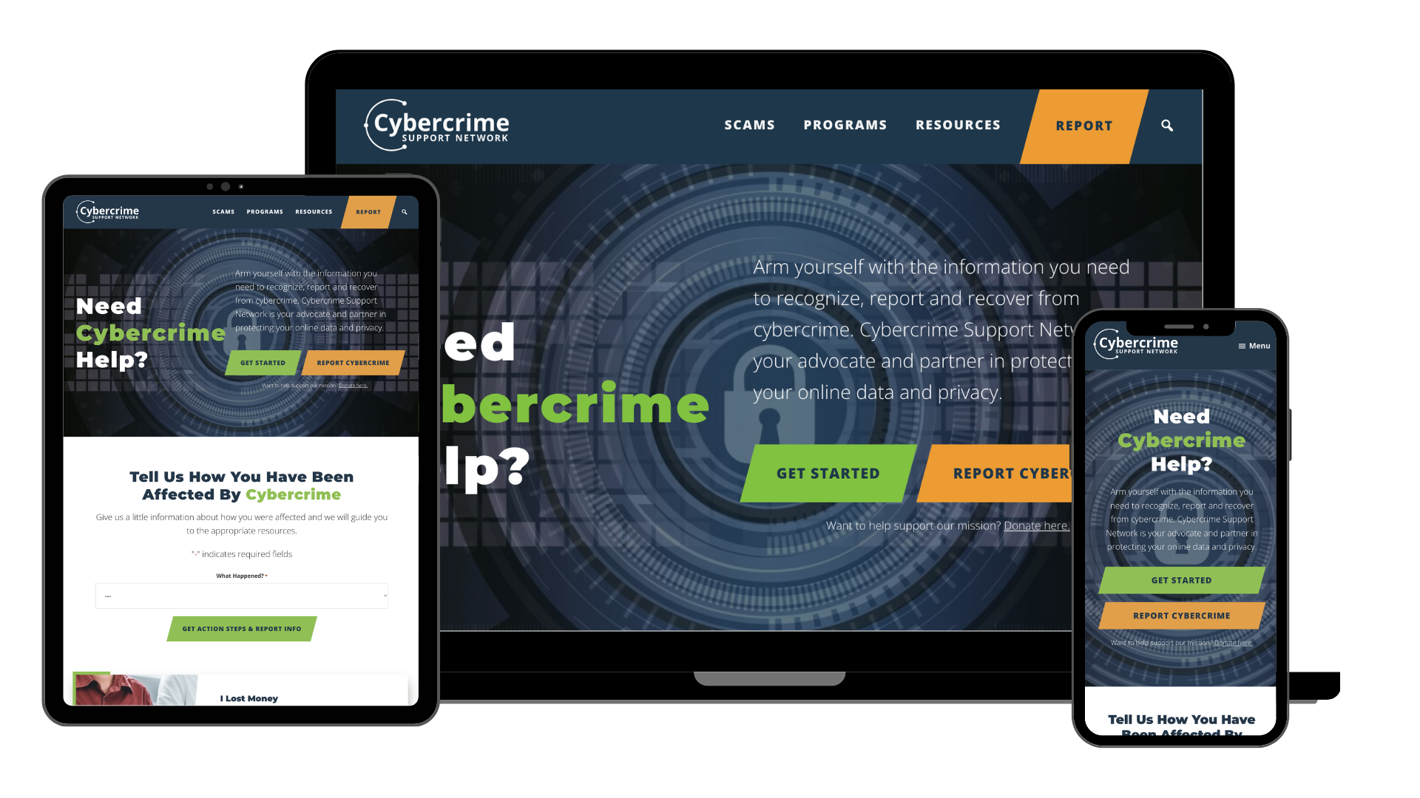
FightCybercrime.org
Resources for individuals
Searchable by scam type
Guides visitors through the
recognize, report,
and recover process

Slide 12


Thank you.
Dr. Jennifer Lawrence
Lead RSRG Program Counselor
jen@cybercrimesupport.org
FightCybercrime.org
Find us on:

