Slide 1
BEYOND SCARCITY
Reimagining Abundance
in Challenging Times
Lynn Willis
Director of Family Stability Initiatives
Sabrina Smith
Community Lending Manager
Jenefeness Franke, MBA
Financial Therapist
Notes:
I invite you all to explore how scarcity mindsets shape decision-making and organizational practices when addressing the needs of ALICE families.
I will be drawing from the "Sites of Shaping" framework, allowing us to reflect on personal and systemic perceptions of abundance and scarcity.
My hope is that you will leave this session with a greater propensity to shift to an abundance-oriented approach that can improve program design and outcomes specifically for Black and Brown communities.
I loved Donna's language yesterday when she talking about the shift from sefl sufficiency to Financial Mobility; so I canged my presentation from Stability to Mobility with that in mind.
I agree that language is essential and monumental.
I am super hopeful that you will take away some actionable strategies to incorporate abundance thinking into your organizational frameworks.

Slide 2


OBJECTIVES
Impact of Scarcity & Abundance On Our Brain
The “Sites of Shaping” Framework
Personal & Organizational Practices (Guided Activity)
Strategies for Breaking Scarcity Cycles and Fostering Financial Resilience
Strategies for Implementing Abundance-Based Solutions
Commitments & Next Steps
Notes:
In this jampacked, powerful and interactive session, I plan to cover
1. The Impact of Scarcity & Abundance on our Mindsets
We will explore how scarcity thinking affects financial decision-making, both personally and institutionally.
Learn how abundance-oriented approaches create long-term financial stability for ALICE families.
2. Introduce/Engage with the “Sites of Shaping” Framework
Breaking down the six interconnected sites that shape the financial mindsets.
Discuss how systemic and personal factors reinforce cycles of scarcity or abundance.
3. Reflect on Personal & Organizational Practices
through a Guided activity where we Map where scarcity and abundance shows up in our own financial mindset.
Identify how your organization’s policies and programs may unintentionally reinforce scarcity. And then determine where it shows up for ALICE families.
4. Explore Healing Money Trauma & Financial Resilience
by understanding how historical and generational financial trauma impacts Black and Brown communities.
Discuss strategies for breaking scarcity cycles and fostering financial resilience.
5. Also going to Identify Strategies for Implementing Abundance-Based Solutions
Shifting from resource-based financial bandaids to trauma-informed financial empowerment that is sustainable.
Learn how to build financial belonging through equity-driven programming.
Explore case studies of success where communities have transitioned from scarcity to abundance.
6. Then lastly, Take Action & Commit to Change by
Developing a personal or organizational action step to integrate abundance thinking into your financial programs.
This is where we answer the questions - What shifts can we start making today to foster financial healing and resilience?

Slide 3

OUR BRAINS IN CRISIS CAN NOT MAKE SOUND FINANCIAL DECISIONS
Dopamine (motivation and reward)
decision fatigue
reduced motivation
immediate, short-term goals
Oxytocin (trust and connection)
shame and isolation
unwilling to ask for help
suspicious of resources
Notes:
Scarcity and continual financial trauma have profound effects on the brain’s chemistry and function, particularly through the neurotransmitters like dopamine and oxytocin.
These chemicals regulate motivation, stress response, and social bonding, meaning that prolonged financial stress can rewire the brain, making it harder for individuals to break free from cycles of economic hardship.
1.🧠 Dopamine is the brain’s reward and motivation neurotransmitter—it fuels our drive to pursue opportunities and take action toward our goals.
Chronic financial stress and trauma decreases dopamine production, leading to decision fatigue and reduced motivation to seek financial solutions.
When someone is in survival mode, their brain focuses only on short-term survival, making it harder to plan long-term financial strategies like saving or investing.
The "scarcity loop" keeps individuals in a cycle where they focus on immediate soothing actions (like buying the purse or taking the trip) rather than big-picture planning (like paying the rent or saving money).
🔴 Example:
A person who has lived from paycheck to paycheck for years may struggle to believe that financial improvement is even possible. Their brain has adapted to scarcity, stopped producing enough dopamine-driven motivation to seek new opportunities (e.g., applying for better jobs, investing, or learning financial literacy).
2. 💞 Oxytocin is the bonding and trust hormone—it helps people build relationships, feel secure, and form strong communities.
Continual economic hardship leads to Shame/isolation, making individuals less likely to ask for help, trust financial institutions, or engage in collective economic efforts.
Many Black and Brown communities have historically been exploited by financial systems (e.g., redlining, predatory lending), making it harder to trust wealth-building strategies especially now in our current political climate with the DEI rollbacks, and imigrant targeting.
Without high oxytocin levels, people may fear financial success because it seems unfamiliar or unattainable.
🔴 Example:
A family that has experienced generational poverty and discrimination in banking may hesitate to engage in financial systems (e.g., investing, buying homes, applying for business loans), which leads to missed opportunities for wealth accumulation.

Slide 4

WE CAN REWIRE OUR BRAINS WITH NEUROPLASTICITY
Dopamine (motivation and reward)
small, achievable goals
reward system
re-education and unlearning
Oxytocin (trust and connection)
community-based support
trauma-informed education
storytelling
Notes:
The good news is we can rewire our brains to move from Scarcity to Abundance with Neuroplasticity.
Neuroplasticity is the brain's ability to change and adapt throughout life by forming new neural connections. It allows people to relearn behaviors, shift mindsets, and recover from past experiences, including financial trauma and scarcity-based thinking.
So, for those of us who have experienced financial trauma and prolonged stress there is hope!
✅ To increase dopamine (motivation & reward):
Set small, achievable financial goals to trigger dopamine release.
Create reward systems around money habits (e.g., celebrating savings milestones).
Engage in financial education to build confidence and motivation.
✅ To increase oxytocin (trust & connection):
Foster community-based financial support (e.g., cooperative economics, mutual aid).
Repair financial trust through trauma-informed financial education.
Encourage storytelling around financial resilience, helping people see examples of abundance.
✅ To reduce cortisol (stress & fear):
Shift financial coaching from shame-based narratives to empowerment-based approaches.
Encourage mindfulness and stress-reduction techniques in financial planning (e.g., taking breaks before making big financial decisions).
Reframe money as a tool for growth and well-being, rather than a constant source of stress.
Final Takeaway: Scarcity Rewires the Brain, but Abundance Can Heal It
Financial trauma isn't just about money—it’s about brain chemistry, stress, and survival. The more we understand how scarcity affects dopamine, oxytocin, and cortisol, the more we can design trauma-informed financial programs that help Black and Brown communities shift from financial fear to empowerment.

Slide 5

WHERE DOES THIS SCARCITY MINDSET COME FROM?
Notes:
We’re going to explore how our mindsets around abundance and scarcity are influenced by various layers of our lives.
These layers are what we call 'Sites of Shaping,'
Is anyone already familiar with Sites of Shaping Framework?
The sites of shaping are powerful forces that impact how we view and interact with money, resources, and opportunities.
By understanding these sites, we can begin to reframe scarcity mindsets and foster a culture of abundance for the communities we serve, especially ALICE families and black and brown families who are typically furthest away from access.
The 'Sites of Shaping' framework helps us reflect on where abundance and scarcity show up in our lives.
It breaks down our experiences into six interconnected layers or sites.
These layers reveal how societal structures, personal beliefs, and community dynamics shape our behaviors and perceptions.

Slide 6
1.SITES OF SHAPING
SPIRIT/LANDSCAPE
Notes:
The Sites of Shaping framework helps us examine how financial mindsets are influenced by different layers of our lives. Each site/layer can
reinforce scarcity—a feeling of never having enough—
or abundance—a belief that resources can grow and sustain communities.
1. Spirit/Landscape (The Cultural and environmental influences on financial beliefs)
Scarcity Example: A person from an oppressed community might feel that their ancestors were stripped of generational wealth and land, leaving them with a sense of financial hopelessness. They may internalize financial struggle as part of their identity. And then it becomes almost impossible for them to change/adapt
Abundance Example: Some Indigenous and African cultures emphasize reciprocity, stewardship, and interconnected wealth—believing that financial wellness is tied to communal and spiritual well-being rather than individual accumulation..

Slide 7
2.SITES OF SHAPING
SOCIAL NORMS/
HISTORICAL FORCES
Notes:
The Sites of Shaping framework helps us examine how financial mindsets are influenced by different layers of our lives. Each site/layer can
reinforce scarcity—a feeling of never having enough—
or abundance—a belief that resources can grow and sustain communities.
2. Social Norms/Historical Forces (Systemic inequities, racial wealth gaps, and societal expectations around money)
Scarcity Example: Black and Brown families have historically been excluded from wealth-building opportunities like homeownership due to redlining, systemic oppresion and white supremacy. This can create a belief that financial success is unattainable, leading to cycles of debt reliance or fear of investment.
Abundance Example: Recognizing historical patterns allows communities to break the cycle through financial literacy, cooperative economics, and community-led investment models (e.g., credit unions, land trusts, and reparations movements).

Slide 8
3.SITES OF SHAPING
INSTITUTION
Notes:
The Sites of Shaping framework helps us examine how financial mindsets are influenced by different layers of our lives. Each site/layer can
reinforce scarcity—a feeling of never having enough—
or abundance—a belief that resources can grow and sustain communities.
3. Institution (Policies, workplaces, and financial systems that shape access to resources)
Scarcity Example: A worker at a company with low wages, no benefits, and no job security may believe they are stuck in survival mode, with no opportunity for financial advancement. Similarly, nonprofit organizations that rely on restrictive grant funding may struggle with a scarcity mindset, thinking they must always compete for limited resources.
Abundance Example: Institutions that prioritize pay equity, financial wellness programs, and employee ownership models create sustainable wealth-building opportunities. Community-centered organizations that seek collaborative funding instead of competitive, scarcity-driven grant models build stronger ecosystems.

Slide 9
4.SITES OF SHAPING
COMMUNITY
Notes:
The Sites of Shaping framework helps us examine how financial mindsets are influenced by different layers of our lives. Each site/layer can
reinforce scarcity—a feeling of never having enough—
or abundance—a belief that resources can grow and sustain communities.
4. Community (Social networks, mutual aid, and collective support systems)
Scarcity Example: In neighborhoods with high poverty rates, residents may feel like financial success means “leaving” rather than reinvesting in the community. They might believe resources are limited and that helping others takes away from their own security. Very competitive versus collaborative
Abundance Example: Communities that embrace cooperative economics (e.g., buying from Black and Brown-owned businesses, participating in mutual aid networks, and supporting group investment models) generate financial resilience and long-term wealth.

Slide 10
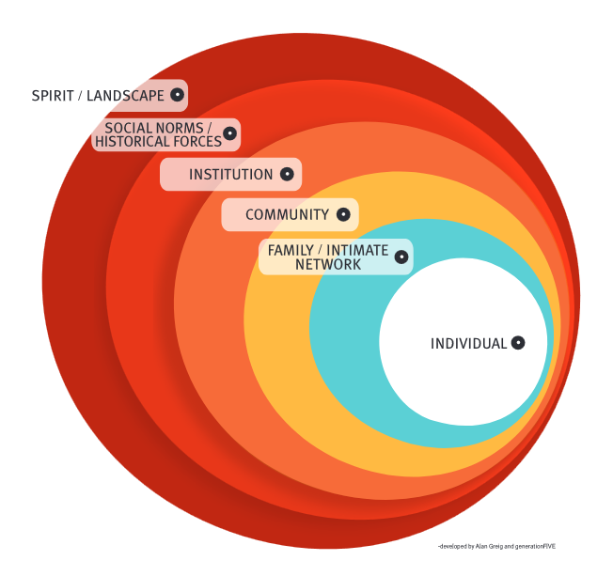

SIX SITES OF SHAPING
Notes:
The six Sites of Shaping are deeply interconnected, influencing one another in ways that shape an individual’s financial mindset, behaviors, and opportunities.
These six sites aren’t just independent categories—they create a system. Shifting one site toward abundance (e.g., improving financial education within families) can spark change across other sites (e.g., shifting institutional policies to support wealth-building).
Understanding these relationships allows organizations, policymakers, and financial educators to take a holistic approach in addressing financial trauma and promoting lasting financial empowerment.
By identifying where scarcity narratives exist in these six areas, individuals and organizations can begin to reframe their approach and implement abundance-based solutions that empower ALICE families and eventually entire marginalized communities.

Slide 11
5.SITES OF SHAPING
FAMILY/INTIMATE NETWORK
Notes:
The Sites of Shaping framework helps us examine how financial mindsets are influenced by different layers of our lives. Each site/layer can
reinforce scarcity—a feeling of never having enough—
or abundance—a belief that resources can grow and sustain communities.
5. Family/Intimate Network (Generational money trauma and financial habits learned from loved ones)
Scarcity Example: A child who grows up seeing their parents struggle with debt, paycheck-to-paycheck survival, and fear around money may internalize the belief that “there’s never enough” and that financial stress is inevitable. Some families pass down the idea that wealth is only for the privileged or that talking about money is taboo.
Abundance Example: Families who openly discuss finances, teach wealth-building habits, and encourage entrepreneurship and investing create financial confidence in younger generations. Parents who model healthy financial decision-making and generosity help break cycles of scarcity.

Slide 12
6.SITES OF SHAPING
INDIVIDUAL
Notes:
The Sites of Shaping framework helps us examine how financial mindsets are influenced by different layers of our lives. Each site/layer can
reinforce scarcity—a feeling of never having enough—
or abundance—a belief that resources can grow and sustain communities.
6. Individual (Personal money mindset, behaviors, and emotional relationship with finances)
Scarcity Example: Someone might believe that no matter how hard they work, they’ll never get ahead financially. They may fear taking risks, avoid looking at their bank account, or feel unworthy of financial success.
Abundance Example: An individual who understands that money is a tool, not a measure of self-worth, will seek financial growth opportunities. They recognize that financial well-being is about resourcefulness and adaptability rather than just income.

Slide 13
SITES OF SHAPING
Interconnected Relationship
Create a System
Changes > Ripple Effect
Notes:
The six Sites of Shaping are deeply interconnected, influencing one another in ways that shape an individual’s financial mindset, behaviors, and opportunities.
Rather than existing in isolation, these sites interact dynamically—meaning that changes in one site can have ripple effects across the others.
Here’s how they interconnect and reinforce scarcity or abundance:
1. Spirit/Landscape → Social Norms/Historical Forces
Our cultural and environmental influences (Spirit/Landscape) shape the way society defines financial success (Social Norms/Historical Forces).
Example: If a cultural tradition values collective wealth (e.g., Indigenous land stewardship, African rotating savings groups), but society enforces individual wealth accumulation as the standard, this creates tension between abundance-based traditions and scarcity-based societal norms.
2. Social Norms/Historical Forces → Institutions
Systemic policies (Institutions) are shaped by historical forces (Social Norms) that have excluded marginalized groups from wealth-building opportunities.
Example: Redlining and discriminatory lending practices were built on racist social norms and became institutional policies, which in turn affected homeownership and generational wealth-building for Black and Brown families.
3. Institutions → Community
Institutions determine the resources and support available to communities, directly impacting economic resilience.
Example: When a city funds small business incubators or minority-owned business grants, it fosters economic abundance in communities. Conversely, if institutions fail to invest in a neighborhood, scarcity grows—leading to economic decline.
4. Community → Family/Intimate Network
The financial culture of a community influences how families approach money.
Example: If a neighborhood has strong cooperative economics (e.g., buying local, supporting Black and Brown businesses), children grow up witnessing abundance in action. But if financial instability is widespread, families may pass down scarcity mindsets.
5. Family/Intimate Network → Individual
The financial behaviors, beliefs, and attitudes learned within families shape an individual's personal money mindset.
Example: If a child grows up hearing “we’ll never have enough” or sees parents stressed about bills, they internalize financial anxiety. But if they learn about investing and entrepreneurship, they develop an abundance mindset around money.
6. Individual → Spirit/Landscape
An individual’s money mindset affects their connection to cultural and spiritual abundance.
Example: Someone with a scarcity mindset may reject the idea of community wealth and hoard resources out of fear. But someone with an abundance mindset may invest in socially responsible businesses, mutual aid networks, or spiritual giving practices that align with their values.
If scarcity is reinforced at multiple sites (e.g., historical racism → institutional barriers → underfunded communities → financially struggling families), individuals often feel trapped in cycles of financial insecurity.
If abundance is cultivated (e.g., empowering policies → community support → family financial education → personal financial confidence), individuals and communities experience greater financial well-being and resilience.
These six sites aren’t just independent categories—they create a system. Shifting one site toward abundance (like improving financial education within families) can spark change across other sites (like shifting institutional policies to support wealth-building).
Understanding these relationships allows organizations, policymakers, and financial educators to take a holistic approach in addressing financial trauma and promoting lasting financial empowerment.

Slide 14

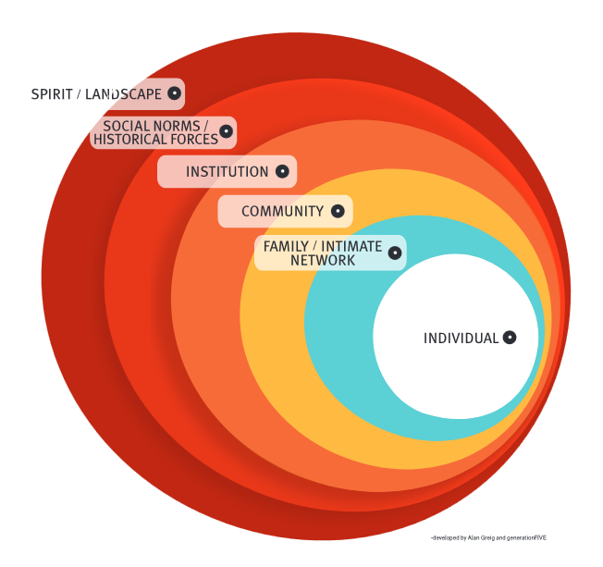
WHERE DOES YOUR SCARCITY SHOW UP?
Let’s Map it out
Notes:
We are going to Identify personal, organizational and community patterns of scarcity and abundance. Let's map it out!
Exercise:
Put an "X" on each site to show where you feel abundance or scarcity.
For Abundance, place it anywhere above the line.
For Scarcity, place it anywhere below the line.
Self Reflection: What patterns emerge? How does your privilege show up in these sites?
Organizational Reflection: What patterns emerge? How does this influence decision-making in your organization?
1. Personal & Organizational Reflection
What patterns of scarcity did you notice across the different Sites of Shaping?
Which site had the strongest impact on financial decision-making for ALICE families?
How does scarcity in one site (e.g., institutions) create challenges in another (e.g., family or individual)?
Were there any unexpected realizations about how ALICE families experience scarcity?
2. Emotional & Psychological Impact
How do stress and survival mode impact the financial decision-making of ALICE families?
What feelings came up as you reflected on these scarcity experiences? (e.g., frustration, sadness, anger, motivation)
How might generational financial trauma be shaping the way ALICE families engage with money?
3. Systemic & Institutional Influences
In what ways do workplace policies, government systems, and financial institutions contribute to scarcity mindsets?
How does the scarcity narrative affect ALICE families’ trust in financial institutions and support systems?
Are there specific policy changes that could help reduce scarcity in the lives of ALICE families?

Slide 15
SITES OF SHAPING
MAPPING IT OUT
Yourself
Your Organization
Your Clients
Notes:
We are going to Identify personal, organizational and community patterns of scarcity and abundance. Let's map it out!
Grab your copy of this document here https://drive.google.com/file/d/1X2Bx-9ixFBC09UhV0mVpsxMUqb8Fs1bH/view?usp=sharing
Exercise:
Put an "X" on each site to show where you feel abundance or scarcity.
For Abundance, place it anywhere above the line.
For Scarcity, place it anywhere below the line.
Self Reflection: What patterns emerge? How does your privilege show up in these sites?
Organizational Reflection: What patterns emerge? How does this influence decision-making in your organization?
1. Personal & Organizational Reflection
What patterns of scarcity did you notice across the different Sites of Shaping?
Which site had the strongest impact on financial decision-making for ALICE families?
How does scarcity in one site (e.g., institutions) create challenges in another (e.g., family or individual)?
Were there any unexpected realizations about how ALICE families experience scarcity?
2. Emotional & Psychological Impact
How do stress and survival mode impact the financial decision-making of ALICE families?
What feelings came up as you reflected on these scarcity experiences? (e.g., frustration, sadness, anger, motivation)
How might generational financial trauma be shaping the way ALICE families engage with money?
3. Systemic & Institutional Influences
In what ways do workplace policies, government systems, and financial institutions contribute to scarcity mindsets?
How does the scarcity narrative affect ALICE families’ trust in financial institutions and support systems?
Are there specific policy changes that could help reduce scarcity in the lives of ALICE families?

Slide 16

WHERE DOES YOUR SCARCITY SHOW UP?
My Sites
Notes:
4. Reframing & Shifting Towards Abundance
Where did you see pockets of abundance in ALICE families’ financial journeys?
How can organizations reframe financial literacy programs to focus on building wealth instead of just “getting by”?
What abundance-oriented practices can we integrate into financial coaching, community programs, and institutional policies?
How can mutual aid, cooperative economics, or financial resilience strategies help shift ALICE families out of scarcity?
5. Action & Commitment
What is one small step you or your organization can take to interrupt scarcity cycles for ALICE families?
What resources or collaborations would help support a shift from scarcity to abundance in your work?
What is one message of financial empowerment we can start sharing with ALICE families to break scarcity-based thinking?
Final Reflection:
💡 "If we shifted from a scarcity model to an abundance model for ALICE families, what would financial well-being look like?"

Slide 17

Healing
Financial Trauma
RESPONDING TO FINANCIAL STRESS
Trauma-Informed Approach
Abundance Thinking at Every Site
Culturally Relevant Materials
Financial Reframing
Eliminate Barriers to Access
Notes:
End Poverty through FInancial Healing
Strategies for breaking scarcity cycles and fostering financial resilience
Scarcity mindsets are often inherited through historical exclusion from wealth-building.
Financial trauma is passed down generationally, impacting financial behaviors.
Healing requires:
Practicing abundance thinking in community, not just as individuals or families
Eliminating the barriers to access to resources; taking a look at your guidelines and policies and identifying a better way to support ALICE Families
Recognizing the role of trauma in financial choices.
Reframing money as a tool for empowerment instead of stress.
Reflection: Which of these resonate with you most?

Slide 18

Implementing Abundance-Oriented Approaches
Shift Program Design
Family/Community-Driven Solutions
Retrain Your Staff
Reframe Financial Education
Practice Financial Mobility
Notes:
STrategies for Implementing Abundance-Oriented Approaches
Shift program design from resource-based assistance to capacity-building and financial healing.
"Nothing For Us without Us" - Include the community you are serving in your solutions - Encourage family/community-driven solutions (e.g., cooperative economics, mutual aid networks) -
Train staff on trauma-informed financial practices.
Reframe financial education to focus on power, agency, and long-term stability.

Slide 19
MOVING FORWARD
Lynn Willis
Director of Family Stability Initiatives
Sabrina Smith
Community Lending Manager
Jenefeness Franke, MBA
Financial Therapist
Impact of Scarcity & Abundance On Our Brain
The “Sites of Shaping” Framework
Personal & Organizational Practices (Guided Activity)
Strategies for Breaking Scarcity Cycles and Fostering
Financial Resilience
Strategies for Implementing Abundance-Based Solutions
Commitments & Next Steps
Notes:
What insights resonated with you the most?
How can your organization start shifting from scarcity-based interventions to abundance-oriented solutions?
What resources or collaborations are needed to make this shift sustainable?
Please feel free to write a Review for Fiscal Finesse https://g.page/r/CcalYzwOuuodEAg/review
If you would like a copy of the presentation, you can get it here
https://drive.google.com/file/d/1DqOLbXj1xAqq3clMcfuCUurBbdIrx5ZE/view?usp=sharing

