Slide 1
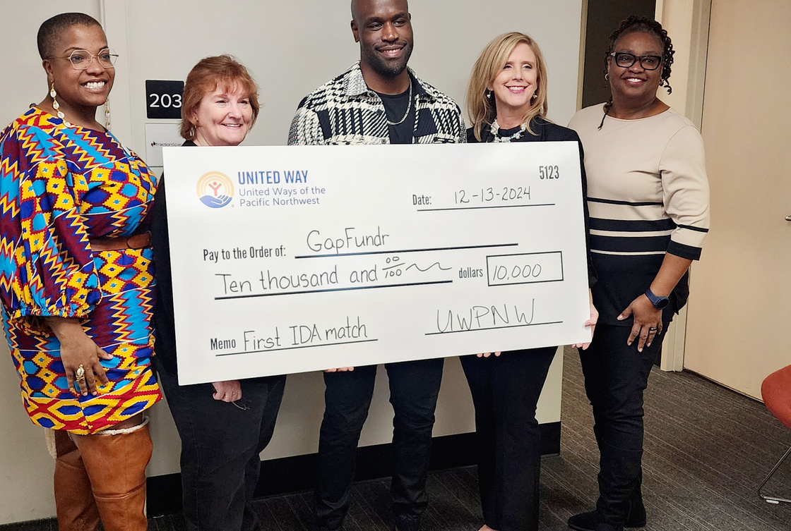

JUNE 2025
UNITED WAY OF PIERCE COUNTY
COMMUNITY REINVESTMENT WORK IMPACT REPORT

Slide 2
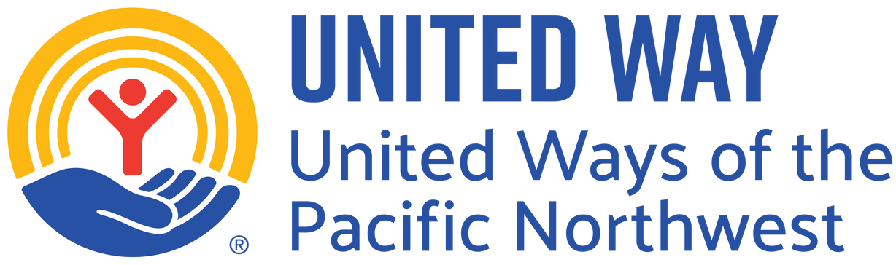
A Formidable Task
In September 2024, United Ways of the Pacific Northwest launched the Community Reinvestment Plan – Asset-Building Project with a $2.5M state grant to support Black, Latine, Pacific Islander, and Tribal communities, in Pierce County.
Through technical assistance, free tax services, and matched savings accounts with coaching, the project advanced United Way of Pierce County’s Bold Goal of helping 15,000 families move out of poverty by 2028.
While short timelines and financial barriers posed challenges, most participants achieved their goals with the support of financial coaches. The report shares key outcomes, lessons learned, and the impact of time constraints on engagement.
Notes:
United Way of Pierce County implemented the Individual Development Account for three counties. Who we served, where we served.
This money could be used to support the following:
Debt remediation
Microenterprise
Home ownership
Education
Transportation
Financial Partners:
Express Credit Union
Self Help Credit Union
Education in Clark County
Community Partners:
Workforce Central
UW Central Washington
UW Clark County
Greater Tacoma Community Foundation
CJK Homes
Harnish Auto Group

Slide 3
Addressing the Needs of ALICE Households
The July 2024 ALICE report shows that 35% of Washington households earn above the federal poverty level yet still struggle to meet basic needs, with disparities especially pronounced in Black, Latine, Pacific Islander, and Tribal communities. In Pierce County, ALICE households have grown from 103,000 in 2017 to 117,000 in 2025, reflecting rising economic pressures on working families.
This surge underscores the need to reassess local poverty-reduction goals and expand support through asset-building and financial assistance strategies.
Source: https://www.unitedforalice.org/demographics/Washington
https://workforce-central.org/2025/04/08/2025-state-of-the-pierce-county-workforce-report/
https://citizenportal.ai/articles/3785737/Lakewood/Pierce-County/Washington/Community-leaders-assess-progress-towards-Pierce-Countys-15000-ALICE-family-goal

Slide 4







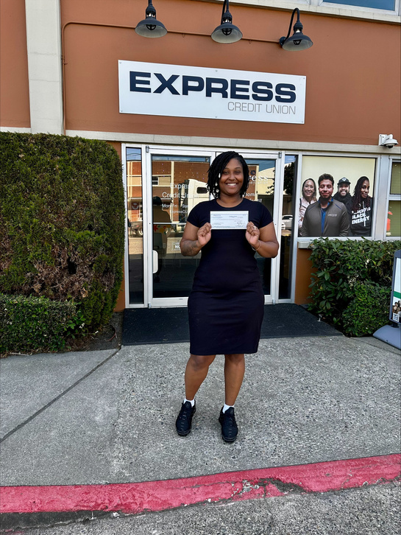
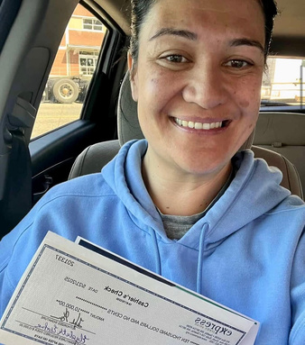
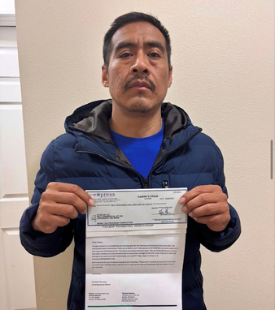

How Financial Coaches Helped Clients Meet IDA Goals
Goal Setting and Planning
Coaches helped clients define specific, measurable savings goals aligned with IDA purposes (e.g. business, education, vehicle.) They developed step-by-step action plans and timelines to guide clients towards their objectives.
Financial Education
Participants received training on credit, debt, banking, and investing. This knowledge empowered them to make informed decisions, avoid financial pitfalls, and build long-term financial health.
Budgeting and Money Management
Clients learned to create and maintain realistic budgets. Coaches identify spending leaks, recommended cost-saving strategies, and help clients prioritize savings over discretionary expenses.
Accountability and Motivation
Regular check-ins with coaches ensured clients stay on track. Coaches provided encouragement, celebrated milestones, and helped clients stay motivated through challenges.
Problem Solving and Resource Management
Coaches assisted with unexpected financial issues like job loss or emergencies. They adjusted plans, connected clients to community resources, and supported credit improvement or debt reduction.
Tracking Progress
Coaches monitored savings deposits, ensured compliance with IDA requirements, and documented progress. They helped clients qualify for matching funds and prepare for final disbursement.
Support
Financial Coaching and Mentoring: Community-based financial coaching programs, funded through the Department of Commerce and the Community Reinvestment Project (CRP), were available to help individuals and families strengthen financial resilience.
Expanding her Grit Mechanical Services
Client received her matching grant for the Cookie Clubhouse
New business owner will build capacity and grow sustainably

Slide 5
Individual Development Account (IDA) Program Highlights
9 Month Results
T
Top Asset Goals:
Microenterprise (most common)
Vehicles (high-impact for work, school, healthcare access)
Housing & debt reduction
The IDA program is driving transformational change. Through culturally grounded financial coaching and strong community partnerships, families are building wealth and securing long-term stability.
IDA Partnerships | Participants | Amount Saved | Amount Matched
United Way of Pacific Northwest - Pierce County | 27 | $205,000 | $205,000
Greater Tacoma Community Foundation (Pierce County) | 15 | $69,505 | $69,505
Workforce Central (2:1 Match - Pierce County) | 14 | $95,300 | $190,600
United Way of the Pacific Northwest - Central Washington | 18 | $117,000 | $117,000
United Way of the Pacific Northwest - Clark County | 21 | $125,000 | $125,000
95
$611,805
$707,105
Total Amount of Assets Achieved: $1,318,908

Slide 6
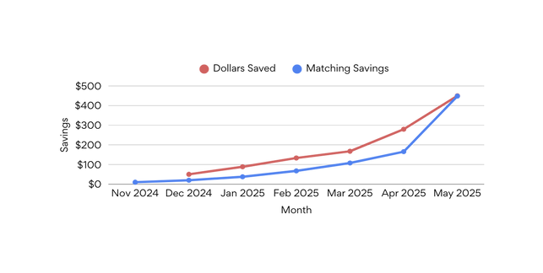
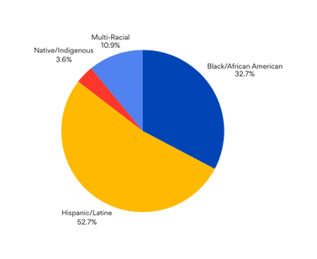
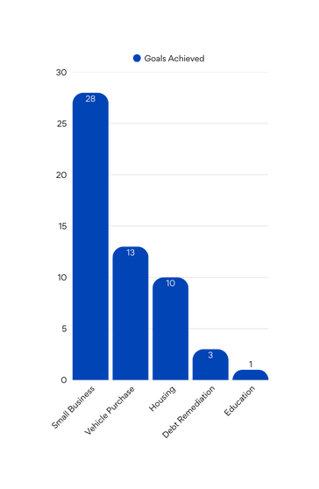
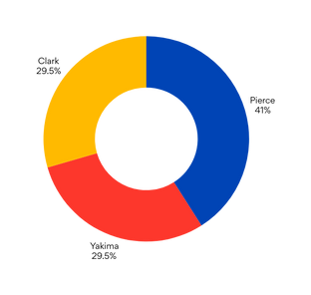
United Way of the Pacific Northwest Key Performance Indicator

Slide 7

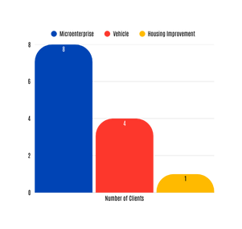

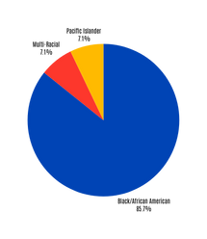
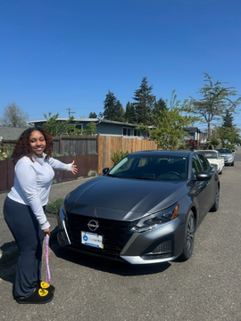
Matched Individual Savings Account (MISA)
4 Month Results - $190,600
For this program, a MISA is defined as a custodial account—managed by Local Workforce Development Boards (LWDBs) and/or their subrecipients (UWPC)—that provides a 2:1 match on participant savings, up to a maximum of $20,000. Participants are eligible to withdraw funds for approved asset-building purposes after completing financial education and coaching and adhering to their individualized Savings Plan Agreement.
Notes:
Matched Investment Savings Accounts (MISAs) are part of the Community Reinvestment Plan (CRP), funded through the Community Reinvestment Funds (CRF) via an interagency agreement between the Washington State Department of Commerce and the Employment Security Department (ESD). MISAs are designed to help participants build future assets or make meaningful investments. While they follow the core principles of Individual Development Accounts (IDAs) outlined in the CRP, they do not meet the statutory definition of an IDA.
For this program, a MISA is defined as a custodial account—managed by Local Workforce Development Boards (LWDBs) and/or their subrecipients (UWPC)—that provides a 2:1 match on participant savings, up to a maximum of $20,000. Participants are eligible to withdraw funds for approved asset-building purposes after completing financial education and coaching and adhering to their individualized Savings Plan Agreement.

Slide 8
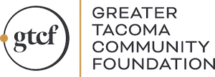
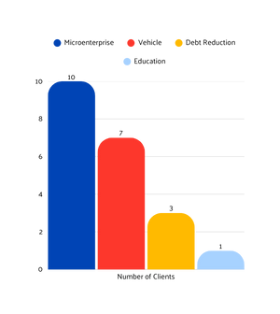
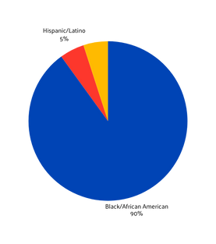
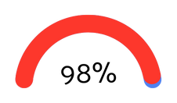
Individual Development Account (IDA)
3 Month Results - $69,505
Savings Goal
Demographics
$70,400 Pledged
GTCF gave over $70,000 to help Pierce County residents obtain assets
Matched Contribution
$69,505 Matched
How much IDA participants were able to save in less than 3 months!
Notes:
As a catalyst for community change, GTCF strategically deployed its discretionary funding to strengthen and accelerate the momentum of both established and emerging local movements.
In its 2024–2025 impact strategy, GTCF committed to amplifying and aligning with initiatives like the Pierce County Local Advisory Team. Through this alignment, GTCF aims to catalyze greater access to government and philanthropic investments, helping community-led efforts grow and thrive.

Slide 9
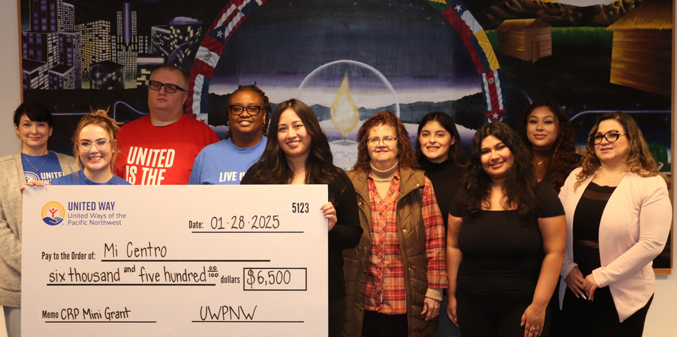
COMMUNITY OUTREACH IMPACT
By and For Partnerships | Amount
Barbara Jean Brown Foundation | $6,500.00
Big Homie Ministries | $6,500.00
Caring with Compassion Community (CwCC) | $6,500.00
CJK Community Homes | $6,500.00
Express Credit Union | $1,960.00
Innovative Change Makers | $6,500.00
Leveled Up Reentry | $6,500.00
Making a Difference Foundation | $6,500.00
Mi Centro | $6,500.00
Our Sisters House | $6,500.00
The Change Program | $6,500.00
Mini-grants
Through the Community Reinvestment Project (CRP) Community Outreach Grant Fund, United Way of Pierce County received $66,666 from United Way of the Pacific Northwest to distribute to local “By/For” organizations—grassroots groups led by and serving Black, Latine, Pacific Islander, and Tribal communities. To maximize impact, UWPC divided the total into 10 mini-grants of $6,500 each, supporting culturally specific organizations that are trusted within their communities. These grants help expand outreach and strengthen organizational capacity.
Pictured above is Mi Centro, one of the recipients, serving Latino and Indigenous Native families through social services, education, and cultural programs like ESL classes, college prep, and arts activities. With a $6,500 Community Reinvestment Project grant, Mi Centro provided laptops to students, expanding technology access and supporting their education.

Slide 10
Impact of Grants
Barbara Jean Brown Foundation – Expanded access to legal support and civil rights awareness for marginalized populations.
Big Homie Ministries – Reduced gang involvement through peer groups, anti-violence campaigns, and youth development.
Caring with Compassion Community (CwCC) – Supported BIPOC individuals with trauma-informed transportation and service access.
CJK Homes – Delivered financial literacy and mental health support for affordable housing residents.
Express Credit Union – Provided multilingual IDA workshops, improving financial literacy and coaching access.
Innovative Change Makers – Expanded peer mentorship and mental health support with a focus on culturally responsive care.
Leveled Up Reentry – Assisted justice-involved individuals with job training, clothing, and transportation support.
Making a Difference Foundation – Distributed weekly groceries to 450+ Tacoma households to address food insecurity.
Mi Centro – Bridged the digital divide through computer literacy and FAFSA workshops in Tacoma’s Latine community.
Our Sisters’ House – Expanded youth coaching, healing circles, and violence prevention programs in Pierce County, increasing outreach and school-based services at Fife High School and Surprise Lake.
The Change Program – Empowered youth through job readiness, personal development kits, and support services.

Slide 11
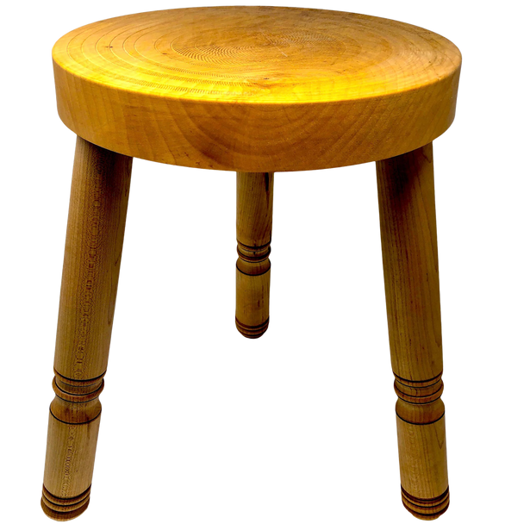
Financial Success Center
United Way Benefactors- Central Washington and Lewis County
United Way of Pierce County was the lead, providing guidance and support to Central Washington and Clark County as they expand efforts to strengthen financial stability in their communities. The Financial Success Center (FSC) model is being actively shared with partnering United Ways as a proven strategy to promote economic mobility and family stability. By integrating financial coaching, employment services, and access to income supports, the FSC framework delivers a holistic approach to helping families achieve long-term financial well-being. This collaboration fosters shared learning, best practices, and stronger local impact—all driven by the goal of building thriving, resilient families.
At the heart of the FSC model are seven core concepts that ensure consistent, high-quality service delivery across host sites: providing comprehensive services in credit, income, and asset building; sequencing support for maximum impact; delivering culturally competent coaching; connecting families to benefits; committing to long-term engagement; using data for continuous improvement; and promoting the Center for Strong Families brand. Together, these principles create a unified system that empowers low-to-moderate-income families to stabilize their finances and build lasting economic security.
Income
Support
Employment Coaching
Financial Coaching

Slide 12
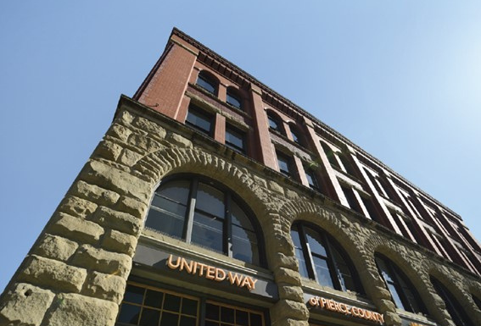



CONTACT US
United Way of Pierce County
The commitment of the United Way of Pierce County to advance over 15,000 families from poverty towards financial stability by 2028 is a powerful and ambitious goal. We thank you for your support.
BOLD GOAL: United, we will lift 15,000 families out of poverty by 2028
MISSION: We mobilize and unite the caring power of Pierce County to tackle our community’s toughest challenges to improve lives in measurable and lasting ways.
OUR CAUSE: We unite the community to end poverty, one family at a time.
CONTACT US
Phone
253-597-7491
Email
csf@uwpc.org
Website
www.uwpc.org
Address
1501 Pacific Ave, Suite 400
Tacoma, WA 98402

