Slide 1


2025 BOWA Annual Forum
Demystifying SBA and Small Business Lending
September 18, 2025

Slide 2
Agenda
What’s the Problem?
Why Should I Bother?
What About the Banks?
A Perfect Storm
Ecosystem of Lending – SBA’s role
Connectors
Capital Landscape

Slide 3
What’s the Problem?
Businesses, and many providers, find navigating access to capital needs very challenging. There is a lot of noise, a lot of info and it’s confusing.
Where do I start?
What do I qualify for?
Where do I focus my efforts?
I don’t know what I don’t know – and I’m fearful it’s not going to go well

Slide 4
Why Should I Bother?
This is a real thing – a very real fear
You have creditworthy small businesses that don’t even try because of this
Many of these businesses fall into underserved categories – women, minority, veteran owned
We need more financial institutions to acknowledge and recognize this. See that we are part of the barriers to entry so we can best help contribute to the solutions
Notes:
​

Slide 5
What About the Banks?
Banks can be scary for a lot of business owners – so how do we break down those barriers?
SBA & Educational opportunities like today are a big part
SBA teams are connectors – if you’re talking to a bank about lending – you need to be sure that banker (or you) are in contact with the SBA Department

Slide 6
A Perfect Storm
All of this leads to a perfect storm – the business owner doesn’t want to talk to bank but also sees the bank as one of their only options. So, what do they do?
They go online to a faceless process that seems easier and less scary
Maybe they Google “quick small business loans” because now they are in a time crunch
We can all guess what options come up
This is what we all need to help prevent – and we can start to do so by understanding the ecosystem of lending and SBA’s role in that better

Slide 7
Role of SBA in the Lending Ecosystem
The overall ecosystem has been changing, especially in a post-Covid world. Digital options via Fintech’s and other online lenders are much more prevalent – but also more predatory as we just discussed.
Why do banks say “No”?
Collateral
Short time in business
Need to rely on projected cash flow

Slide 8
Role of SBA in the Lending Ecosystem
What does the SBA guaranty help banks mitigate?
Collateral
Short time in business
Need to rely on projected cash flow
This is why getting to the SBA Department is so important

Slide 9
Connectors
This is one of the most common words I would use to describe what a strong SBA program does
If the bank you’re talking to says “No” – even with the SBA guaranty – the SBA Department can connect you to non-bank lenders that are many times a better fit
SBA Departments also can see when you’re not ready for lending and connect you to SBA resources to assist – like Score and the Small Business Development Center network
Maybe you want to grow your company through public contracting – the SBA Department can connect you to contracting resources provided by the SBA

Slide 10
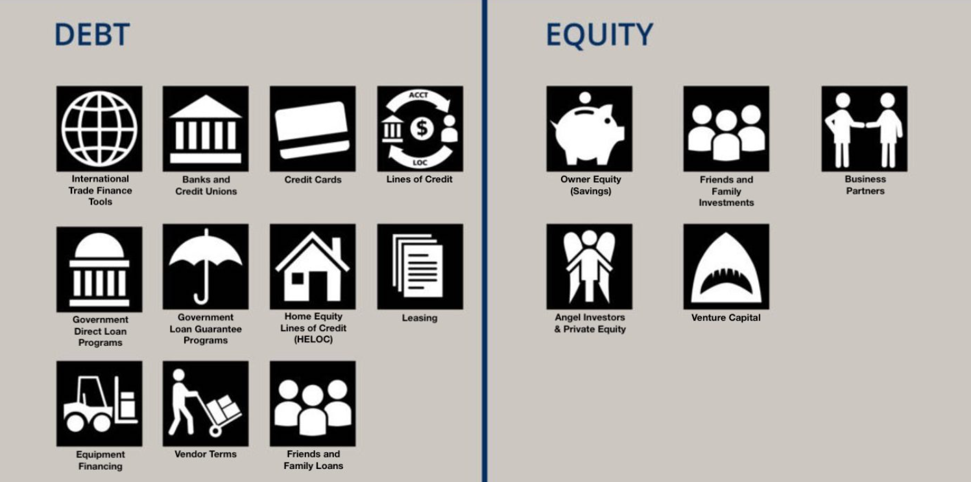
Traditional Capital Landscape

Slide 11
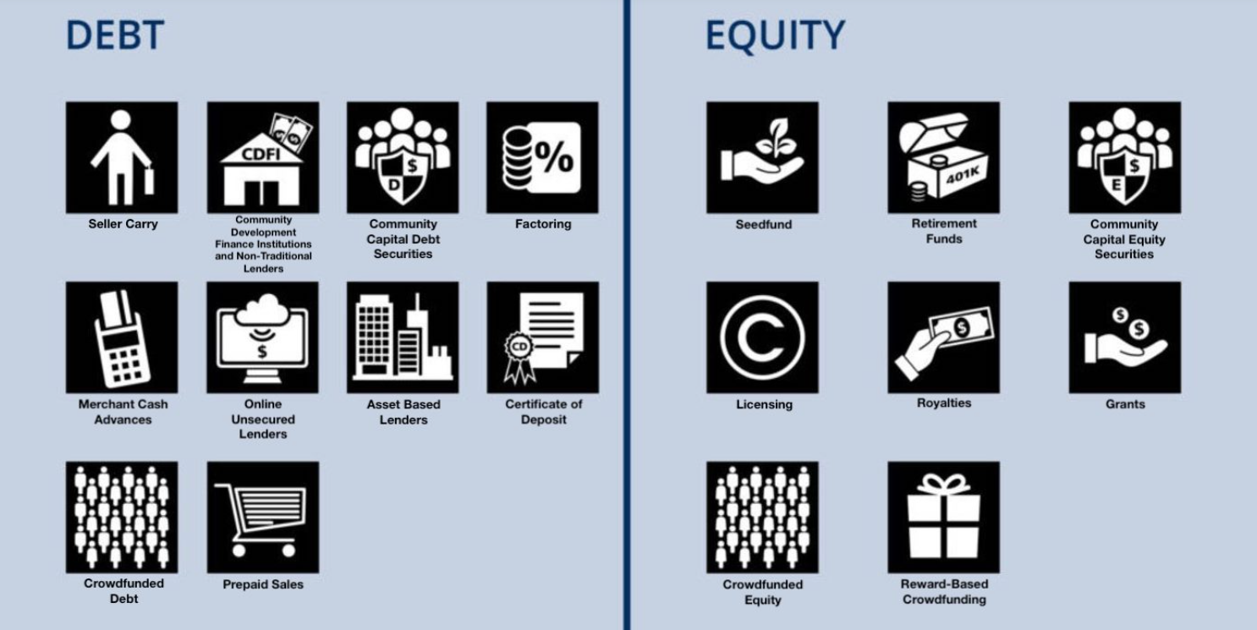
Alternative Capital Landscape

